Slide 1
Augmediated reality system based on 3D camera selfgesture sensing
Authors
Raymond Lo, Alexander Chen, Valmiki Rampersad, Jason Huang, Han Wu, Steve Mann
Presenters
Alexander Chen
Valmiki Rampersad

Slide 2
Table of Contents
Implementation
Segmentation Aid for Object Recognition
Computer Vision Lighting Challenge
Privacy & Social Issue
QR Code Integration

Slide 3
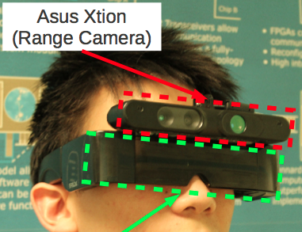
Implementation(Hardware)

Slide 4
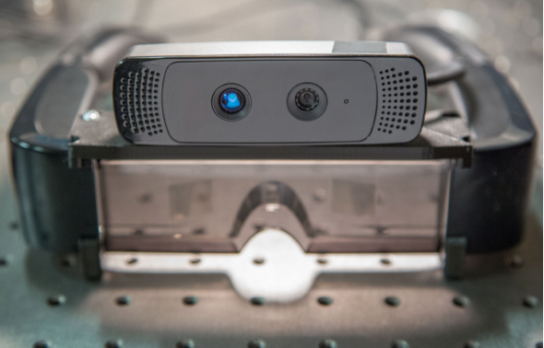
Implementation(Hardware)
Hardware:
Camera: PrimeSense based 3D camera (Kinect or Asus Xtion Pro)
Display: Epson Moverio BT-100
Processor: ODROID-X2

Slide 5


Implementation(Algorithm)
Algorithms:
Segmentation:
using depth and IR images
Classification:
using neural network

Slide 6
Implementation (Segmentation)
Segmentation Background:

Slide 7
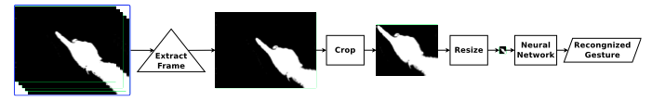
Implementation(Segmentation)
Our Method:

Slide 8
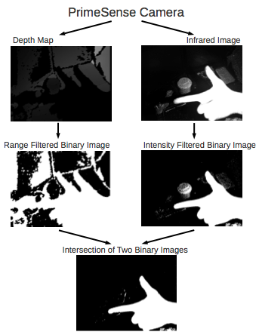

Slide 9
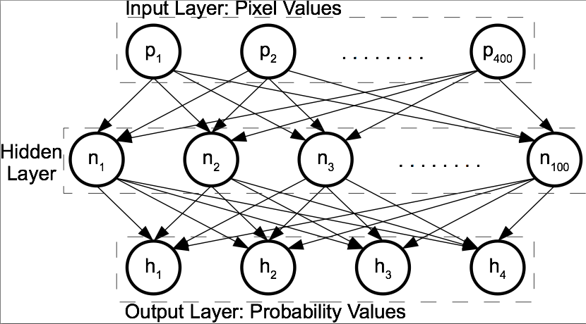
Implementation(Classification)
Classification Algorithm: Single Layer Neural Network

Slide 10
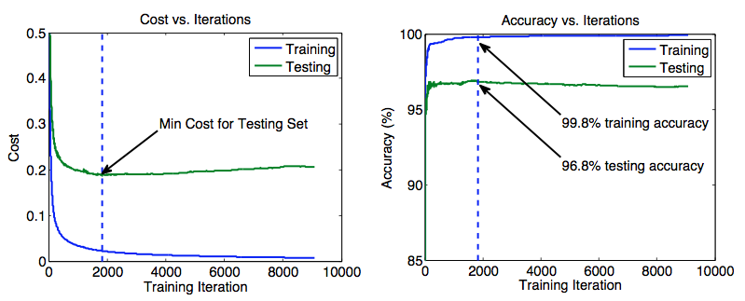
Implementation(Classification)
Early Stopping

Slide 11
Table of Contents
Implementation
Segmentation Aid for Object Recognition
Computer Vision Lighting Challenge
Privacy & Social Issue
QR Code Integration

Slide 12
Segmentation Aid For Object Recognition
Background

Slide 13
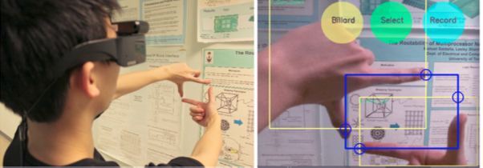
Segmentation Aid For Object Recognition
Our Approach:

Slide 14
Table of Contents
Implementation
Segmentation Aid for Object Recognition
Computer Vision Lighting Challenge
Privacy & Social Issue
QR Code Integration

Slide 15
Computer Vision Lighting Challenge
Demo

Slide 16
Table of Contents
Implementation
Segmentation Aid for Object Recognition
Computer Vision Lighting Challenge
Privacy & Social Issue
QR Code Integration

Slide 17
Table of Contents
Implementation
Segmentation Aid for Object Recognition
Computer Vision Lighting Challenge
Privacy & Social Issue
QR Code Integration

Slide 18
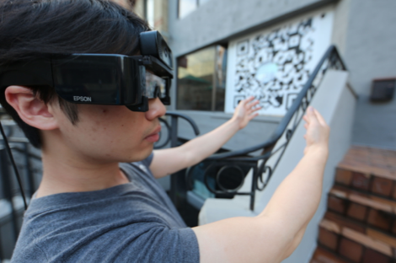
QR Code Integration

Slide 19
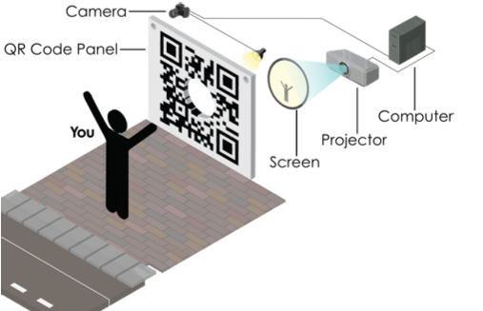
QR Code Integration

Slide 20
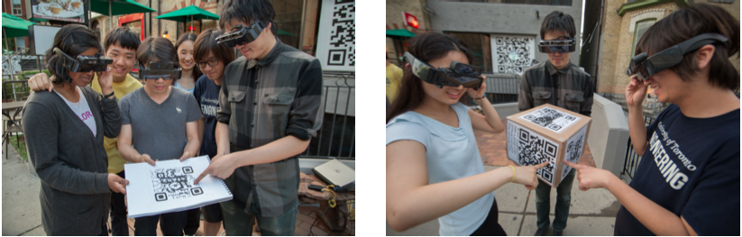
QR Code Integration

